Slide 1
The Power of Partnership
Leveling the Playing field to assist Professionals working with students and Young adults with deafblindness

Slide 2

DeafBlind Central:
Michigan’s Training & Resource Project
USDOE funded project- every state has a project (nationaldb.org)
Statewide
Year around
Training
Consultation
Information & referral
Systems change
Census/Registry

Slide 3
Who should be registered with state deafblind projects?
People who have a documented vision AND hearing loss based on accurate clinical testing
People who are observed to not respond to auditory AND visual information in the same way that their peers do
People who demonstrate having a hearing AND a vision loss based on functional assessments conducted by qualified classroom staff or consultants
People who have a significant vision loss and uni- or bilateral cochlear implant(s)
People who have been diagnosed with progressive losses
People who have additional disabilities, medical concerns
People with any IEP eligibility- NOT only those whose eligibility is DeafBlind

Slide 4
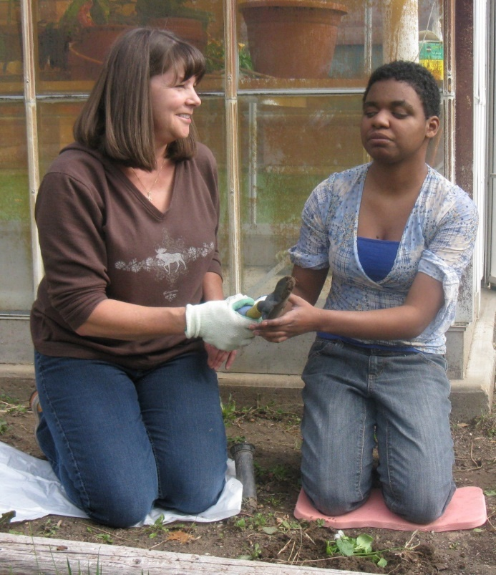
Deafblindness is a disability of access

Slide 5
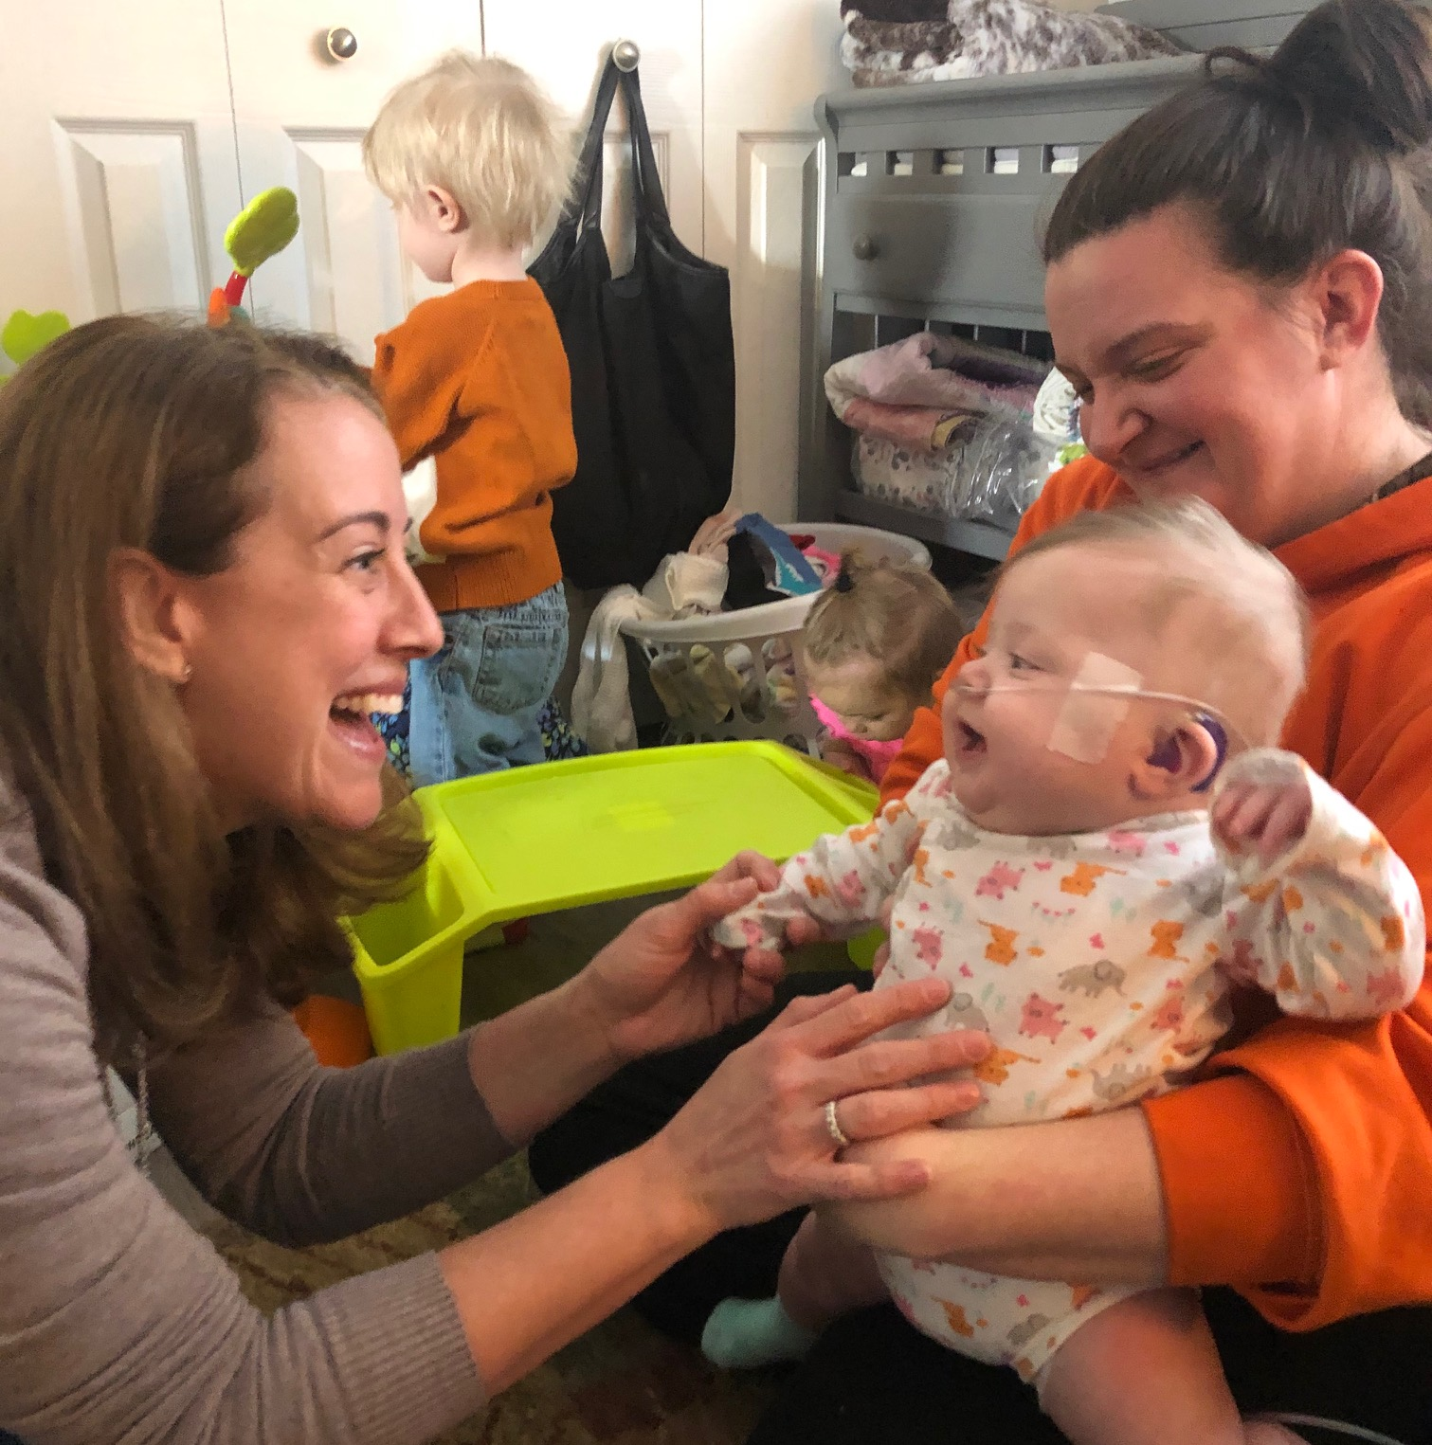
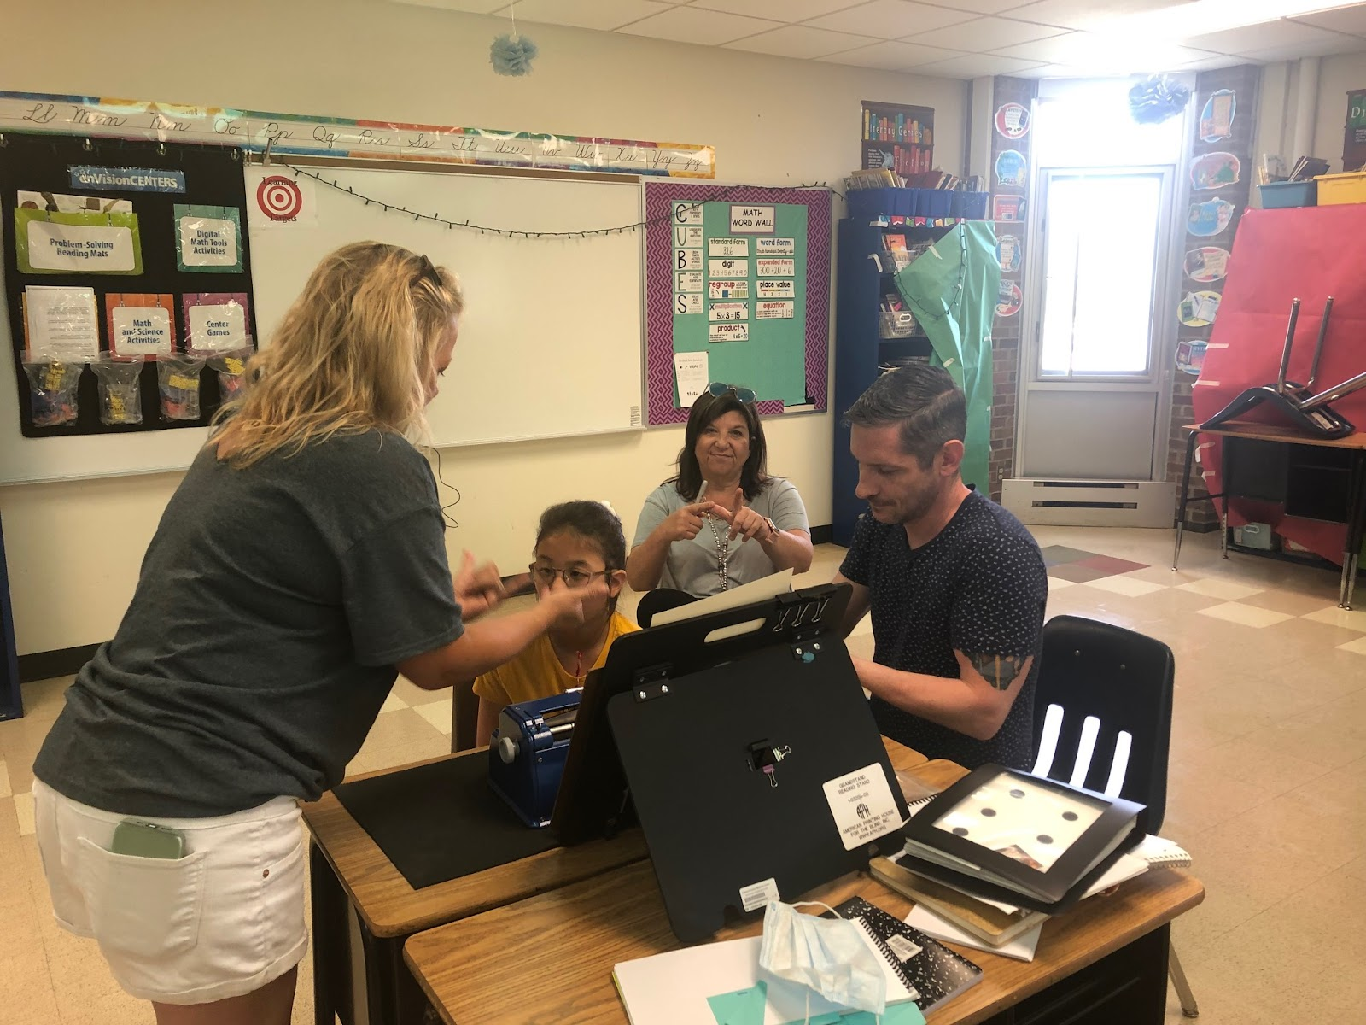
Professionals On Teams with students with DB/Dual Sensory Loss
Certified Teacher DHH
Certified Teacher VI
Notes:
Need a title for this….building the scene of what we have and why this is so important

Slide 6
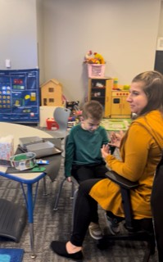
Continued Team
Intervener and or Paraprofessional who has been trained on VI
Orientation and Mobility Specialist
Notes:
Add OM specialist

Slide 7
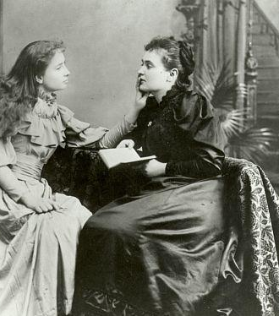
What is an Intervener?
According to the National Center on Deaf-Blindness, 2013 (rev. 2021):
1:1 support for a student who is deafblind
Person who has specialized training in deafblindness and the process of intervention
Someone whose role is to develop a trusting relationship, provide access, help to build concepts, expand on receptive and expressive communication, support the development and maintenance of adult and peer social connections and relationships
A staff person who scaffolds and modulates their support- intervention is a dance
Part of an educational team

Slide 8
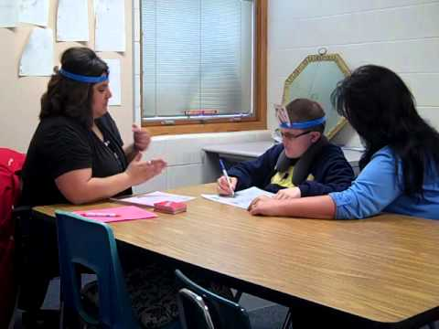
Interveners – Part of the Team
Interveners:
Work with the classroom teacher
Ideally work with a Teacher of the DeafBlind
Are present during therapies and other services
Provide support during assessments
Are a part of team meetings
Are new concepts for school personnel

Slide 9
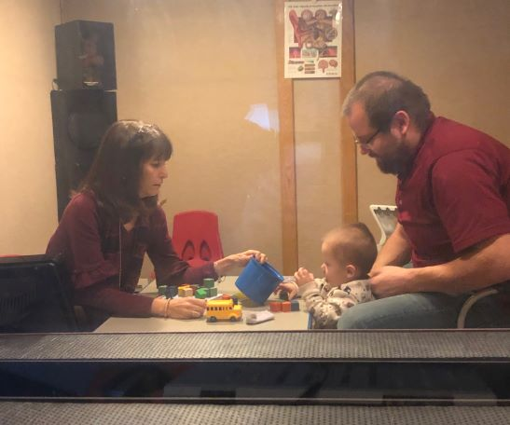
Audiologist

Slide 10
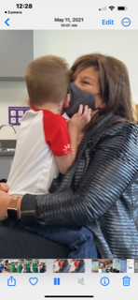
Chewing, swallowing, and “In The Belly”
Notes:
Social interaction while delivering instruction: Noticing, Affirming, Naming, Serve and Return, Beginning/End : expose, breakdown task, sensory opportunity in modality available

Slide 11
In the Beginning…..
I didn’t know what I didn’t know
My thinking:
Out of my element, QUICKLY
Collaborating with DHH teacher; Feeling same way (30 years to present)
Notes:
My story….how we ended up collaborating

Slide 12
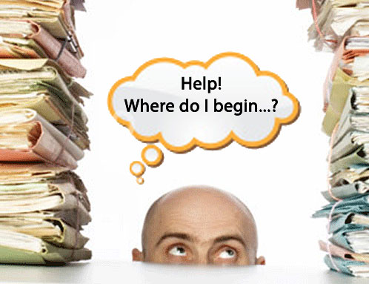
New Learning as a TVI
As TVI, I had countless experiences with DeafBlind…… However;
This Photo by Unknown Author is licensed under CC BY-SA
Notes:
add photo of teaching one hand to sign and other to braille as well

Slide 13
LEANING IN
Learning/requiring more
  Braille readers with profound dual sensory loss
  No access visually, Zero or little access with hearing
  Out of my wheelhouse/How can this be?
Conversations required for me to share information at a level that I have not experienced
  Talking with anybody who will listen
  DB central
  Individual phone calls and assistance/events

Slide 14
Need for collaboration and understanding
Phone calls
Emails
Zoom and in-person meetings
Webinars
Presentations
Module

Slide 15
The ASK is overwhelming
TVI/DHH asking for more information to support students
High Demands/High Numbers
TC’s in DHH and VI assisting teams already; but often separately
Each student uniquely different
Notes:
When I come, information is requested
Often services in our office started separately
Within our office, we share evaluations and do them together, for all dual sensory so we learn from each other

Slide 16
The reality
Low Incidence field is filled with large tanks, but fuel is “low”
  Staff shortages
  No time to learn
  High numbers
  Passion for field does not equal time to learn

Slide 17
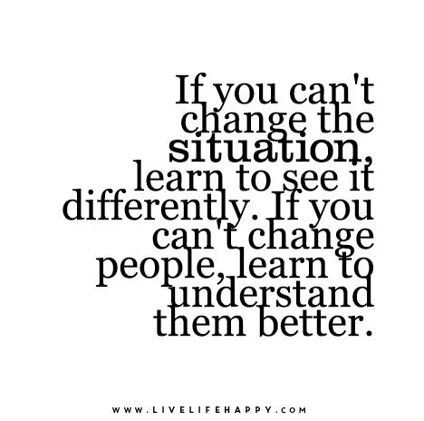
We are required to provide support regardless SO……
This Photo by Unknown Author is licensed under CC BY-SA-NC

Slide 18
Shifting Perspective
Deafblind is a unique disability that requires training specific to the outcomes of the dual sensory loss. The teacher of students with visual impairments and a teacher of students who are deaf and hard of hearing have training specific to each sensory loss, however they may not have experience or training specific to the uniqueness of being deafblind.
Not an additional impairment requiring 2 disciplines
Understanding equals shift in thinking resulting in more comprehensive understanding of this population
Notes:
Trying to not write on slides with my thoughts, but this is hard for me, if you can think of shorter way to make bullet points, I can speak to it without the whole thing being on slides

Slide 19



Direct
Hands-on
experiences
Typical Learning
Secondary
Listening to a person teach or present information
Alsop, 2012
Incidental
Occurs automatically without much effort
The way most information is learned

Slide 20



Direct
Hands-on experiences
are essential.
The best way to learn.
Deafblind Learning
Alsop, 2012
Secondary
is difficult
Incidental
Usually does not occur and is not effective

Slide 21
Level up: Providing Strategies to professionals so they we can do the work
Defining population
Providing strategies that can quickly be utilized after viewing modules
Videoclips
Accountability

Slide 22
The Modules and why they were chosen
Easy to implement strategies quickly and apply in classsroom
Want to have something to USE, with students with DeafBlindness
Teachers DHH/VI/OM can view at leisure with beginning and end date
Difficult to get out of district to attend workshops/IEP mandates make it difficult to miss time with students

Slide 23
If you offer it, they will come!
“I wish I had this information when I first began teaching 12 years ago” –
“I immediately took the strategies discussed (calendar system) into the classroom. For years, I ended the calendar system when they demonstrated proficiency. Now I know that we continue with the system, adding onto it.”
“I though I knew about DeafBlindness but now I feel lilke I wasn’t doing such a good job.”
“Loved it…. Will there be more modules? “

Slide 24
Reasons for Accessing the DB Project
Do you wonder if you have a student who should be registered?
Are members of the team uncertain if more could be done?
Is there a challenging class/activity and you need ideas for making adaptations?
Does the team need some training in deafblindness?
Could the project help to improve family engagement?
Note: The best way to benefit form the project is by having an ONGOING relationship

Slide 25




Partners In deafblindness

